Slide 1
Voicemail System
Architectural views

Slide 2
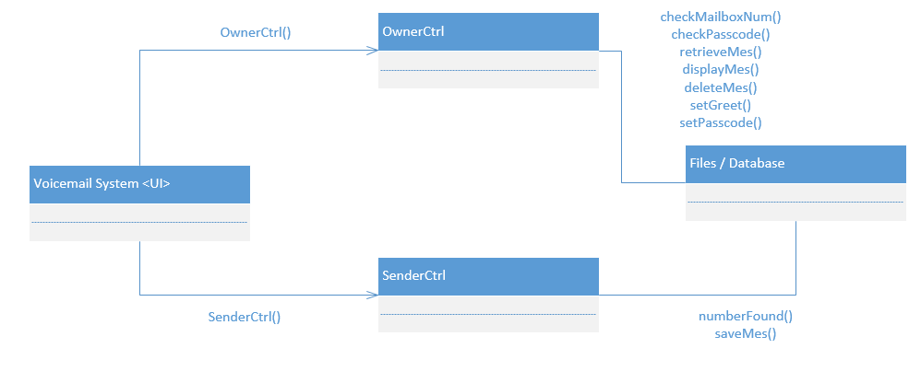
Logical View

Slide 3
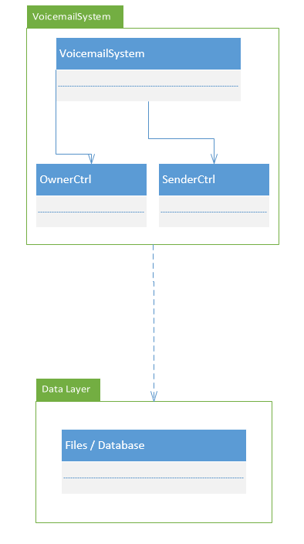
Implementation View

Slide 4
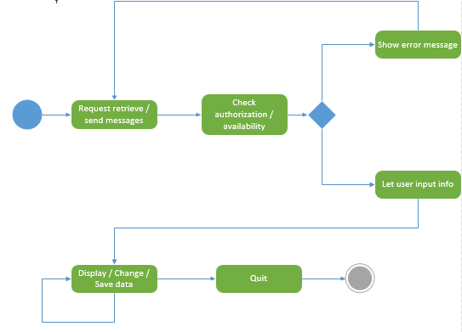
Process View

